Slide 1
FP2030 Measurement Report 2021
2020-2021
1/27/2022
Family Planning 2030

Slide 2
FP2030 Measurement Report 2021 Graphics
Measurement Report 2021
The following graphics are from the FP2030 Measurement Report 2021. They are sized for easy copy and pasting into your presentations.
We encourage their use, but request that the graphics be cited as follows:
  FP2030 Measurement Report 2021
Please see the notes section of the slides for additional information and footnotes pertaining to the graphics.

Slide 3
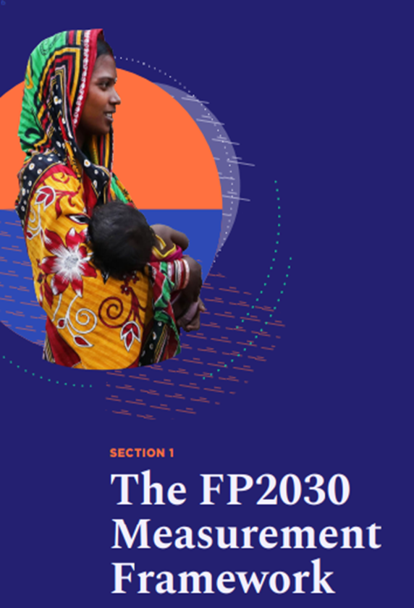
Introduction to the
FP2030 Measurement Framework

Slide 4
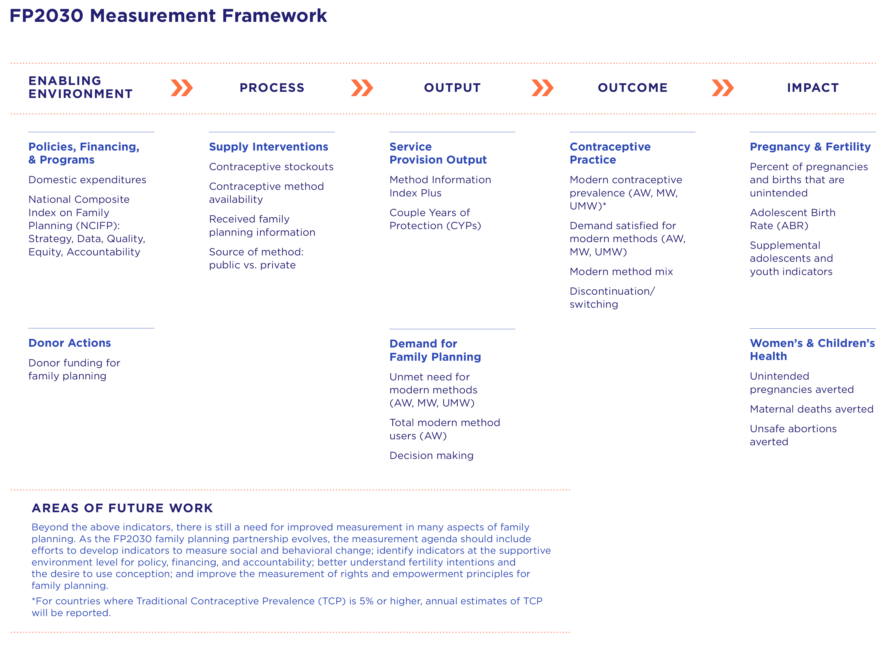

Slide 5
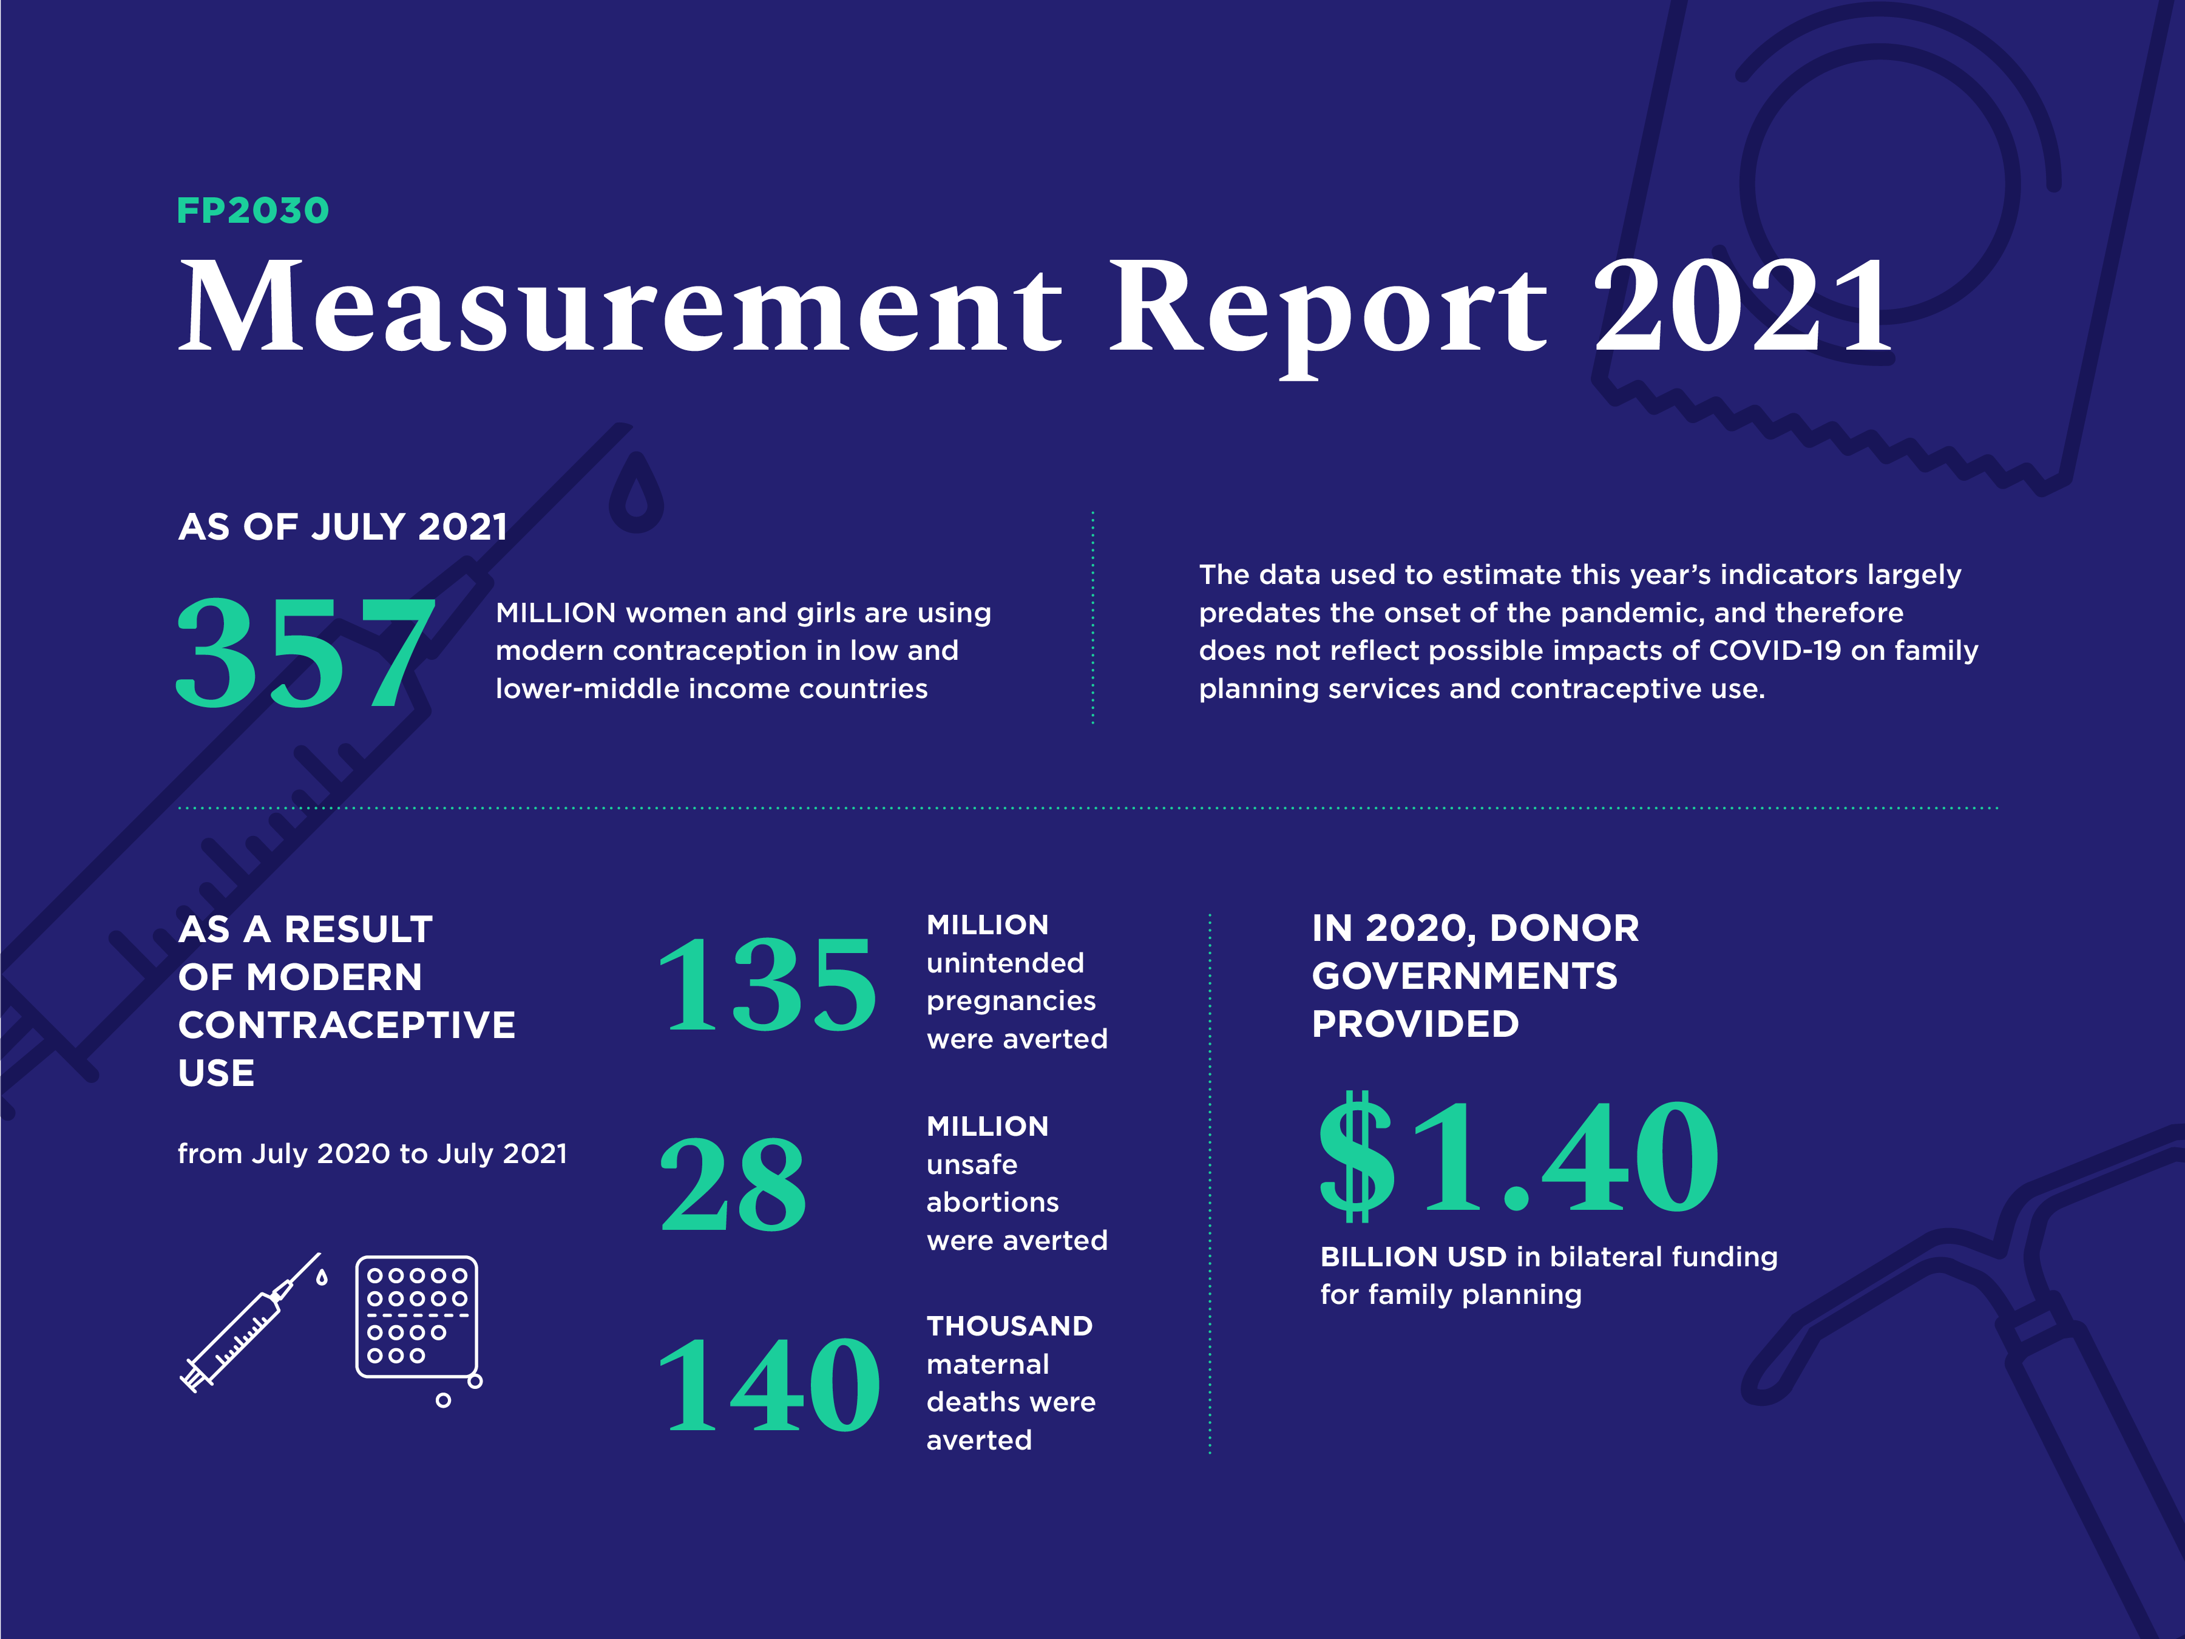

Slide 6
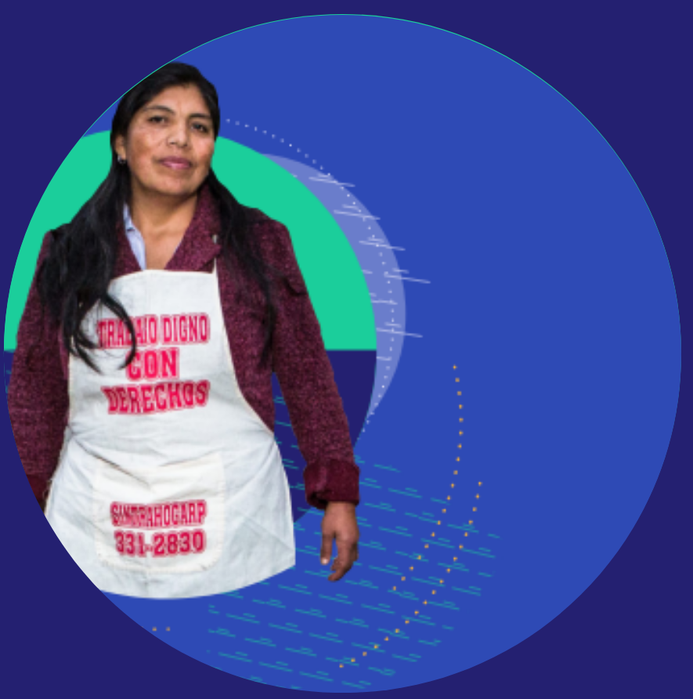
Regional Profiles

Slide 7
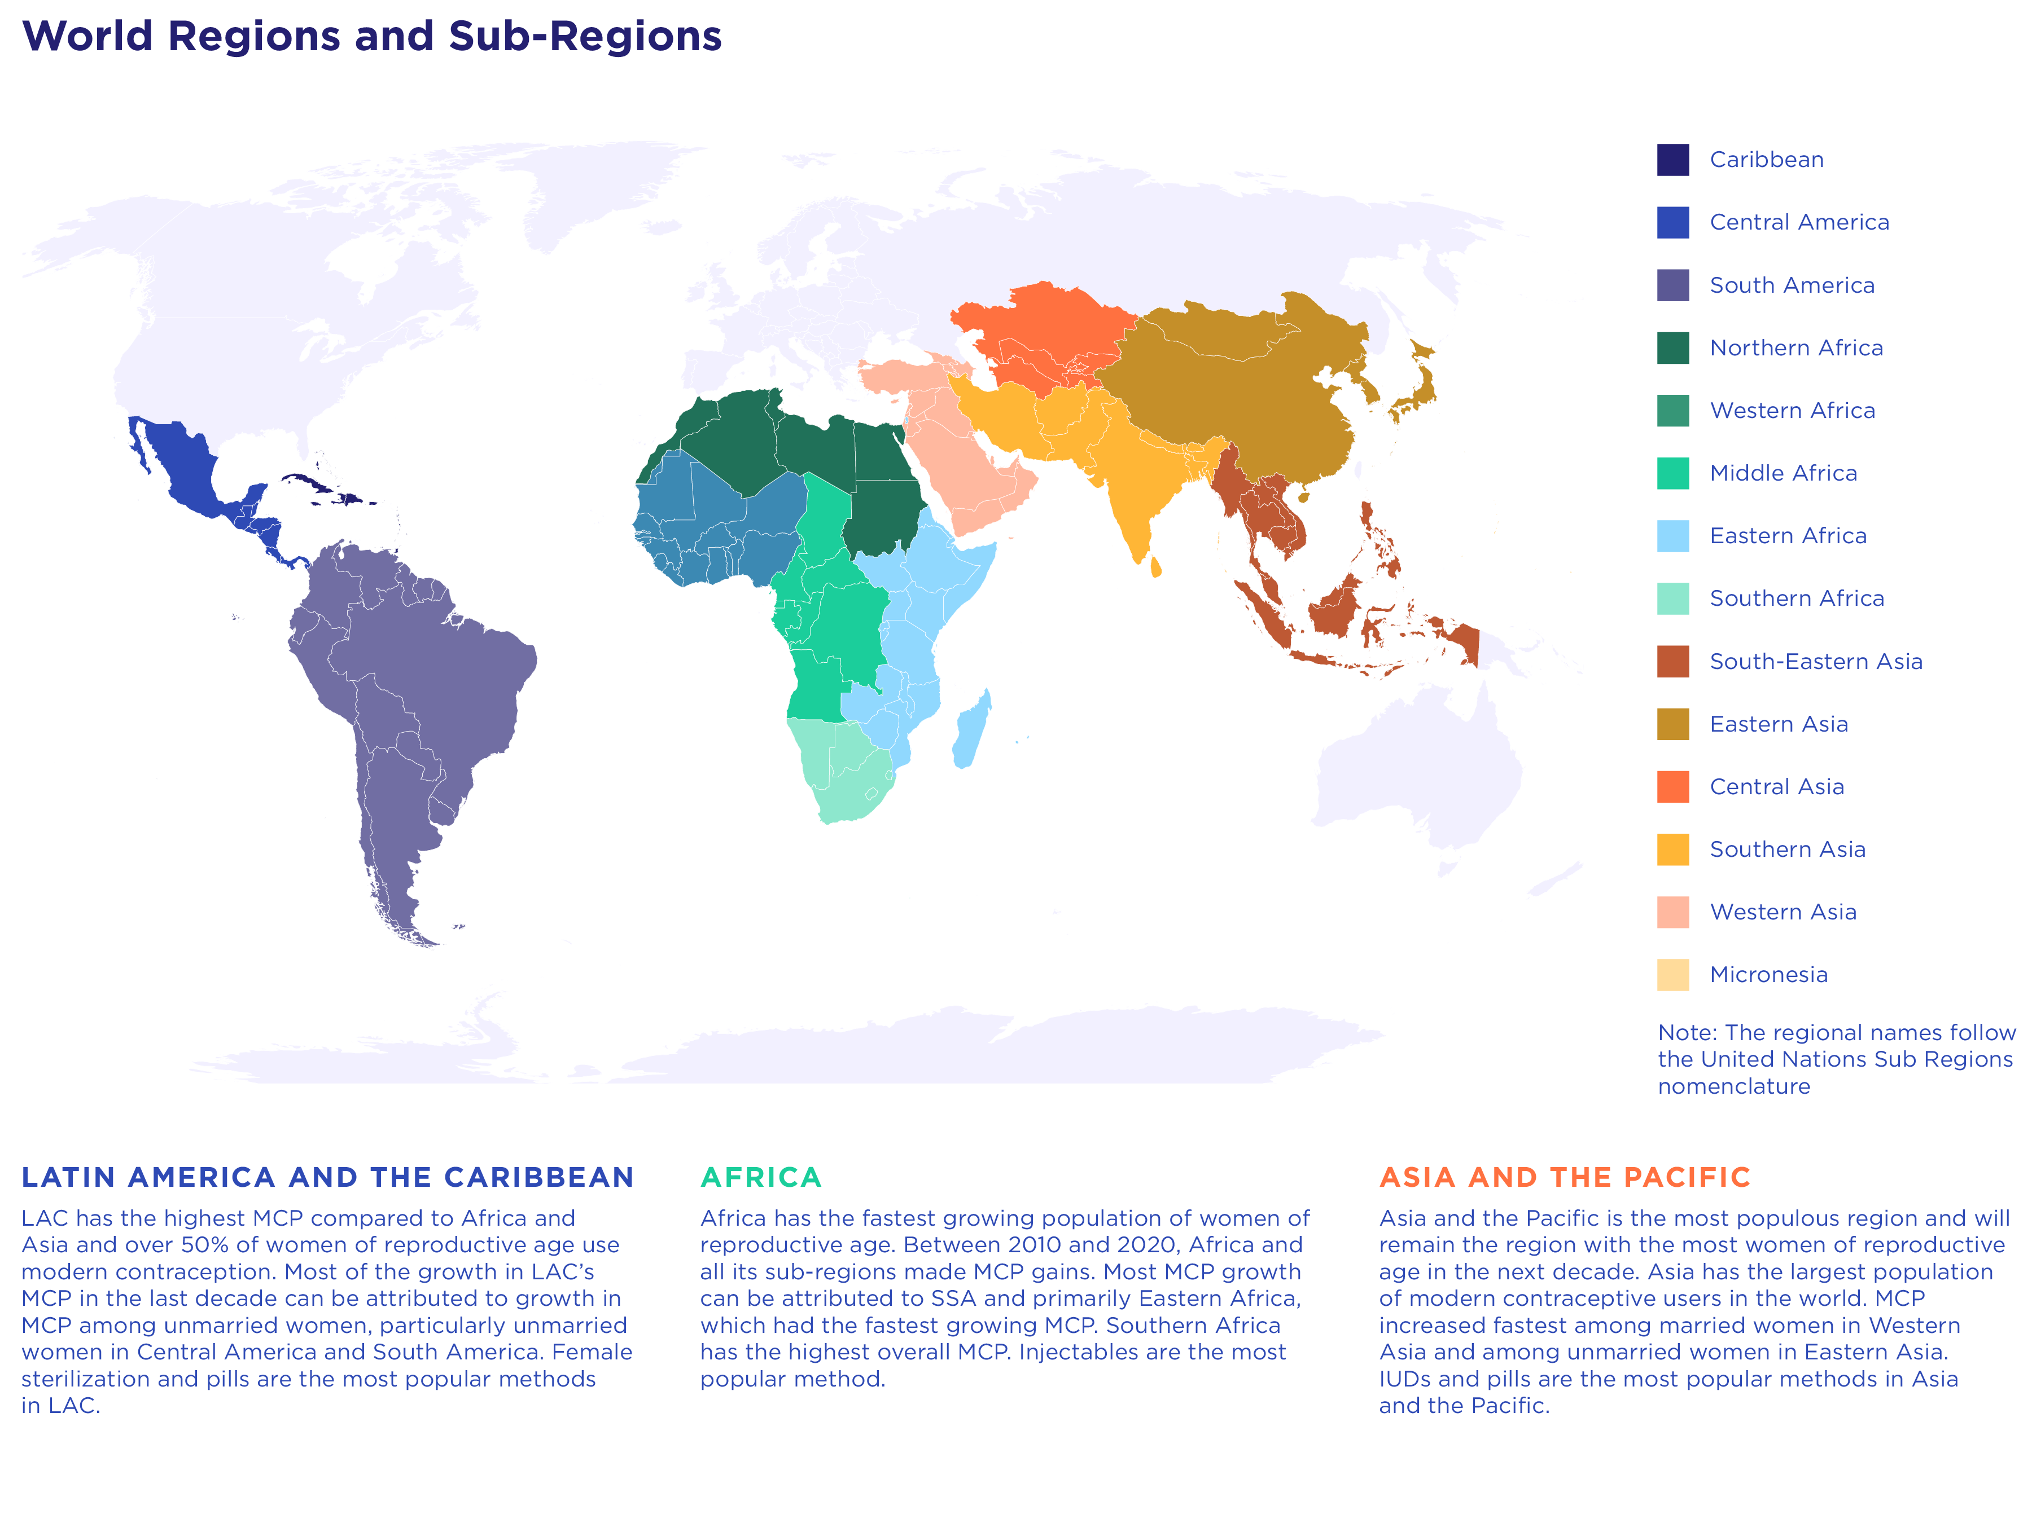

Slide 8
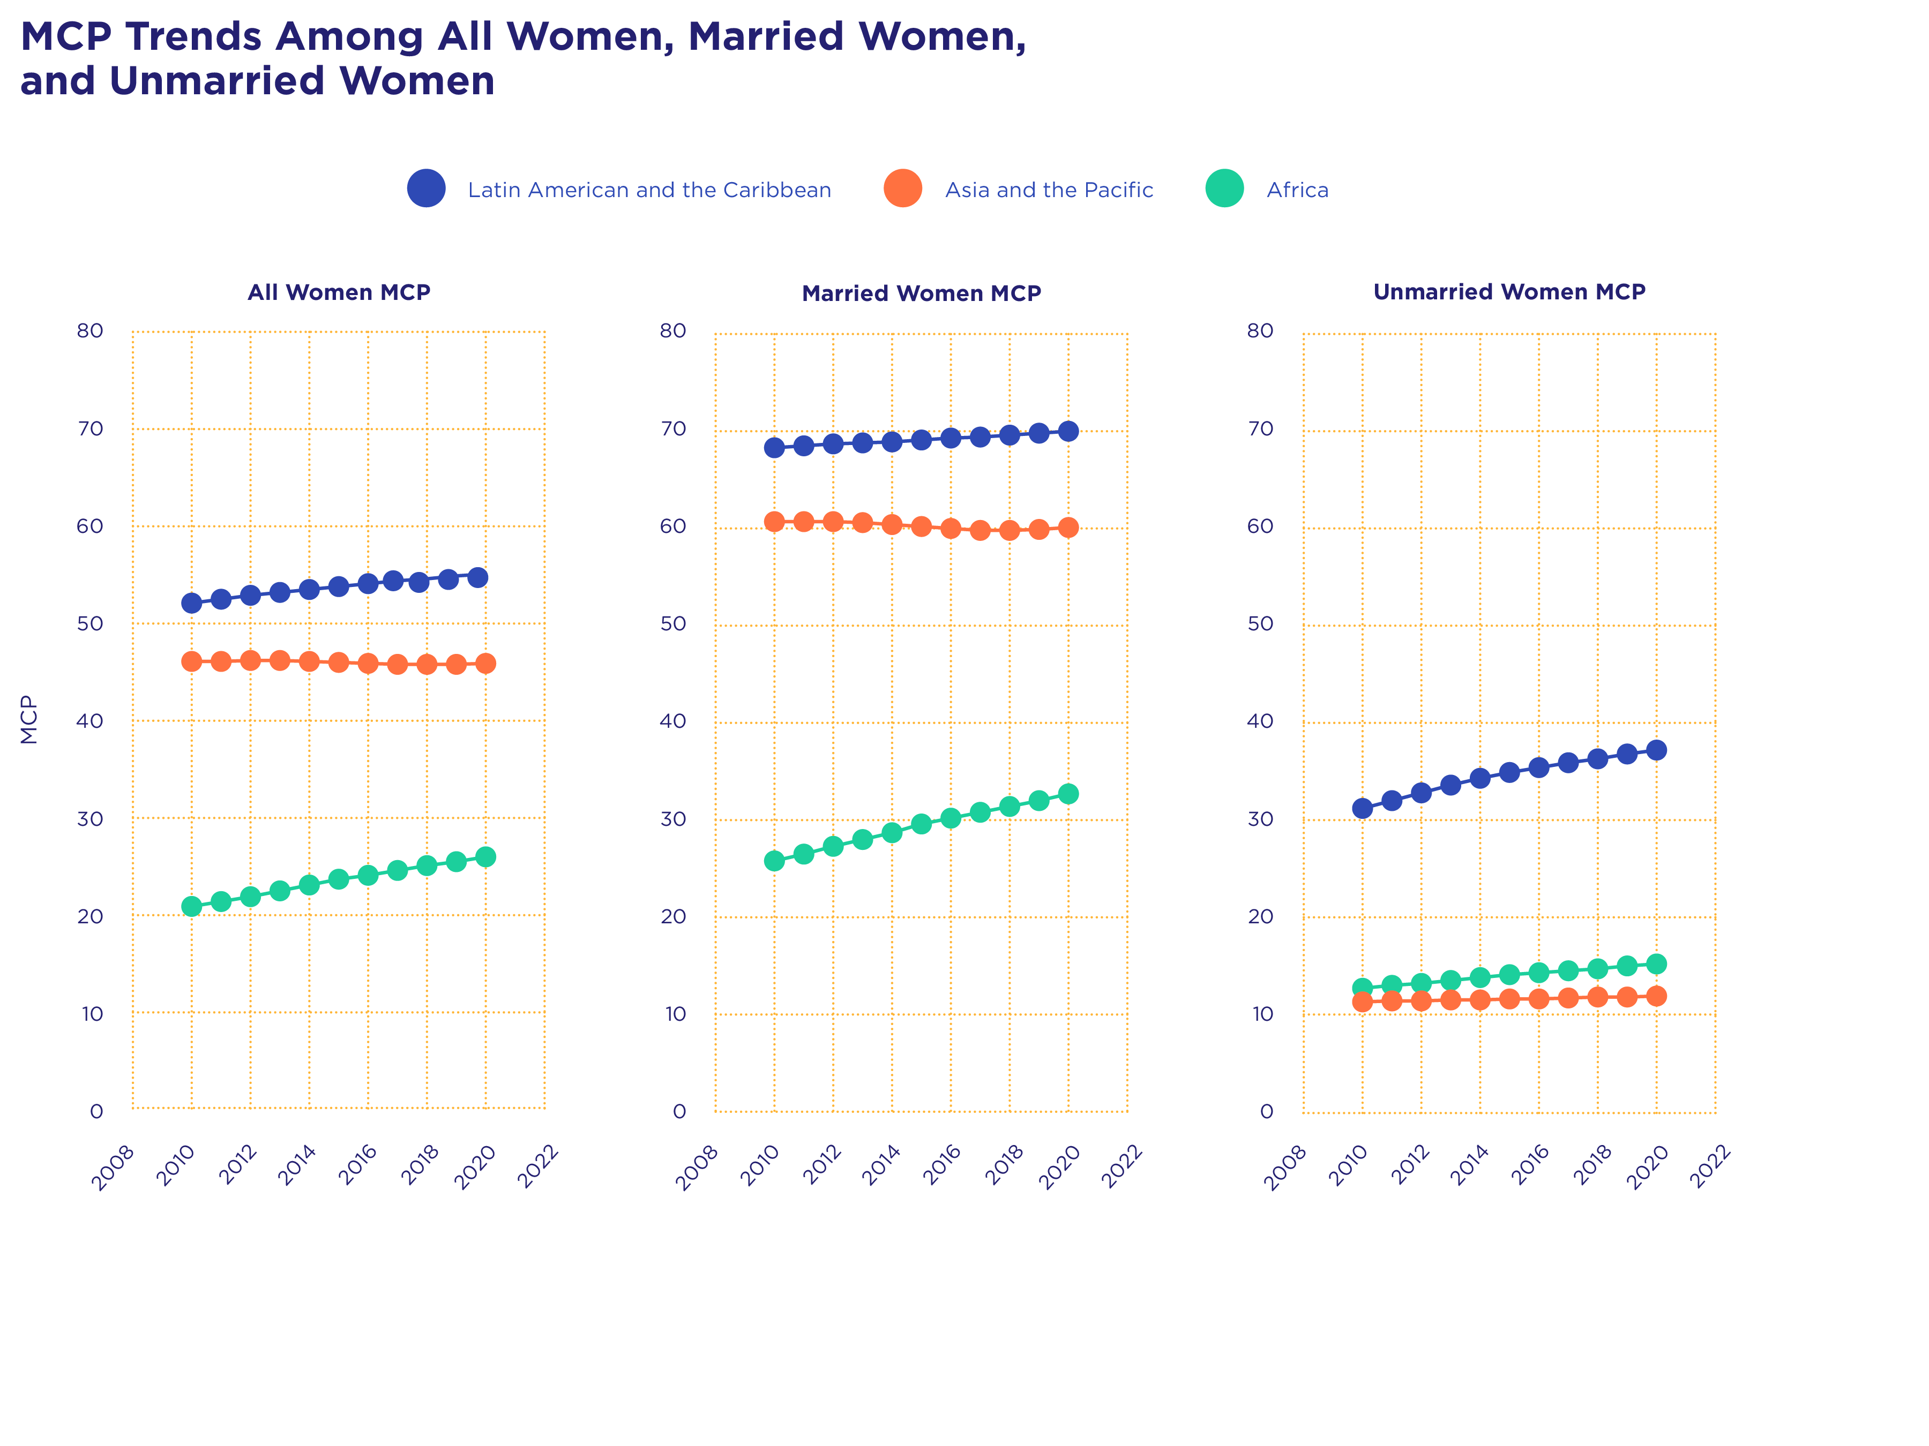
Notes:
This graphic illustrates the trends in modern contraceptive prevalence over the past decade in Africa, Asia and the Pacific, and LAC, showing the breakdown by sub-region and trends for both married and unmarried women

Slide 9
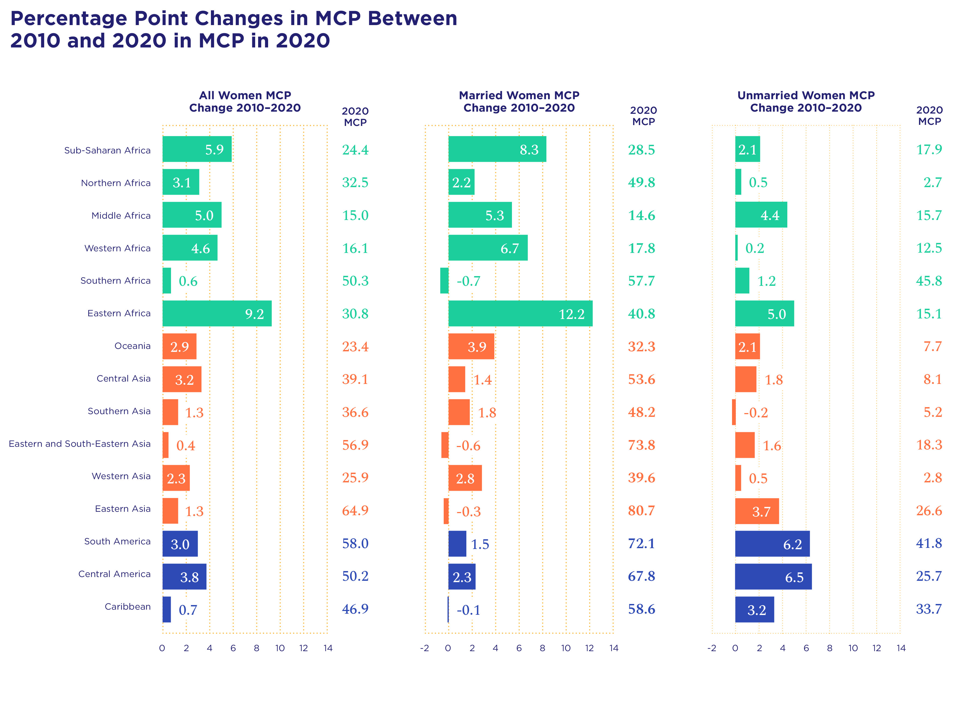
Notes:
This graphic illustrates the percentage point changes in modern contraceptive prevalence between 2010 and 2020 and the modern contraceptive prevalence in 2020 for Africa, Asia and the Pacific, and LAC. The graphic shows the breakdown by sub-region and trends for both married and unmarried women.

Slide 10
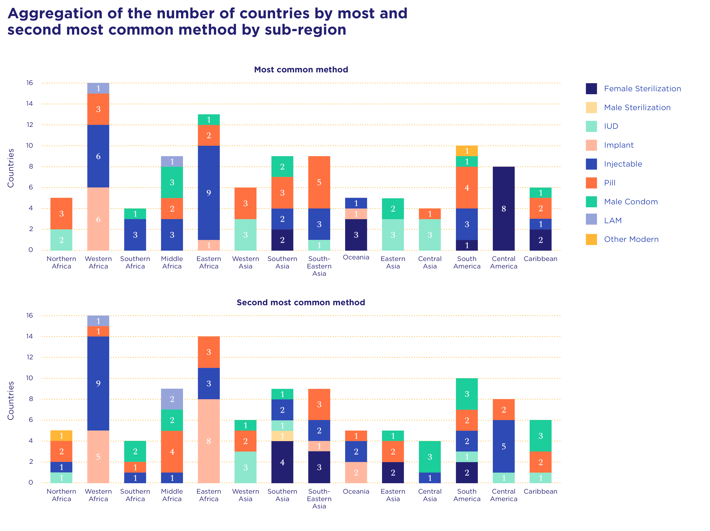
Notes:
This graphic shows a sub-regional breakdown of the most common and second most common contraceptive methods in use across the 47 countries

Slide 11
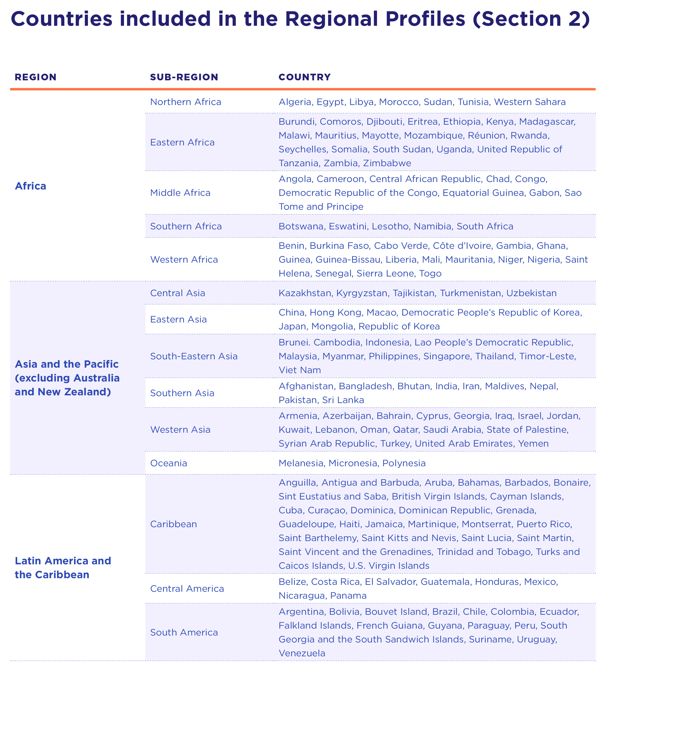
Notes:
Note: The regional names follow the United Nations Sub Regions nomenclature

Slide 12

Finance

Slide 13
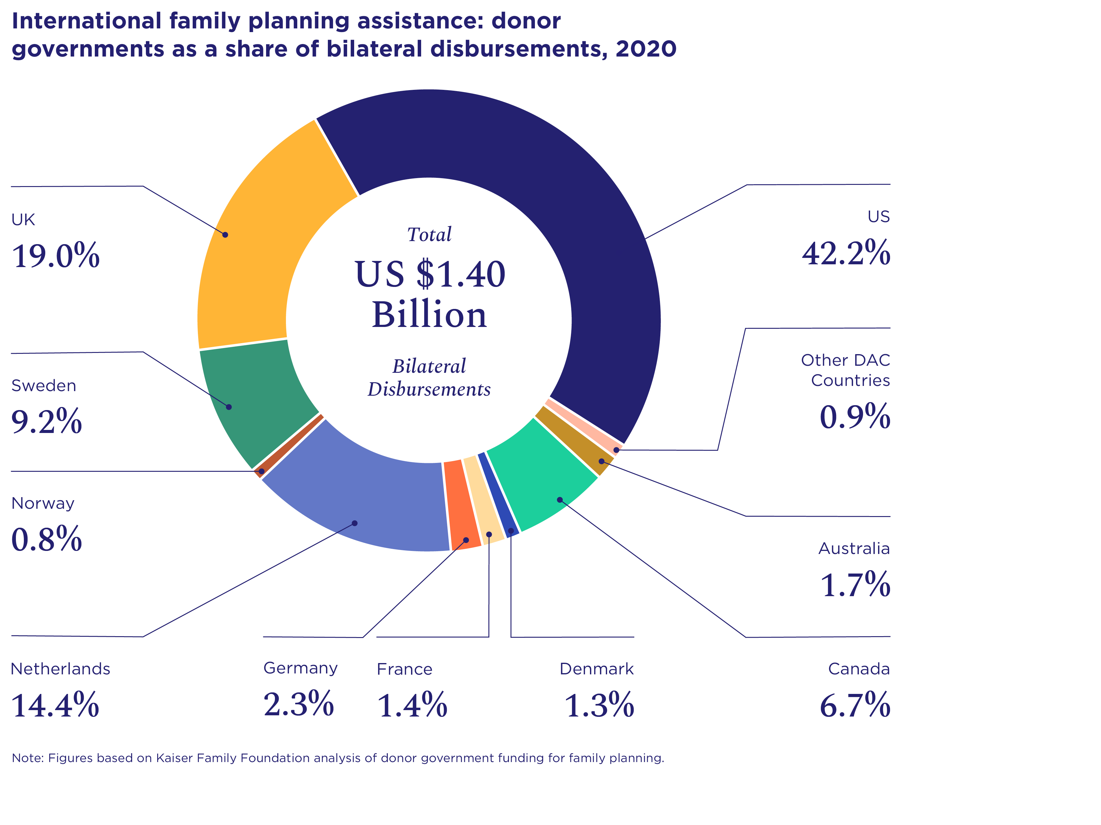

Slide 14
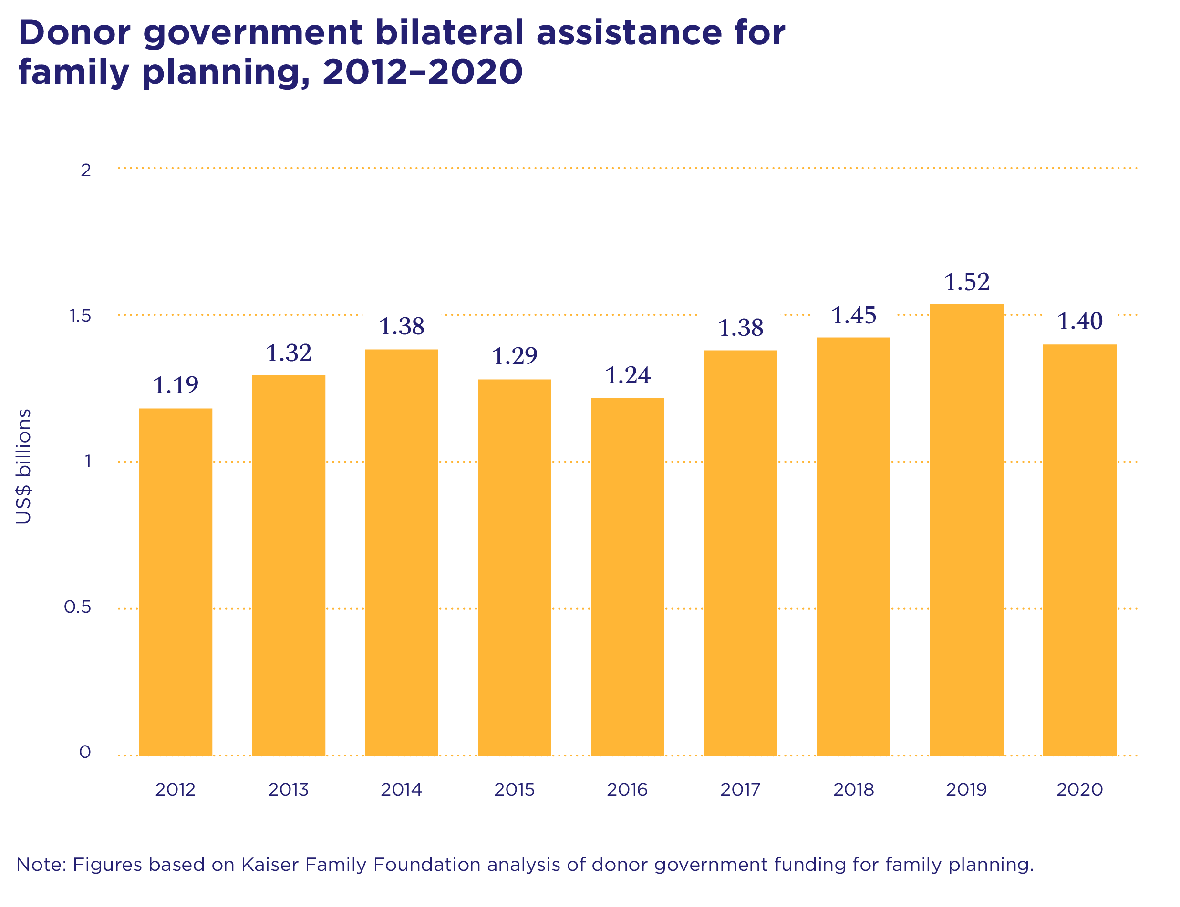

Slide 15
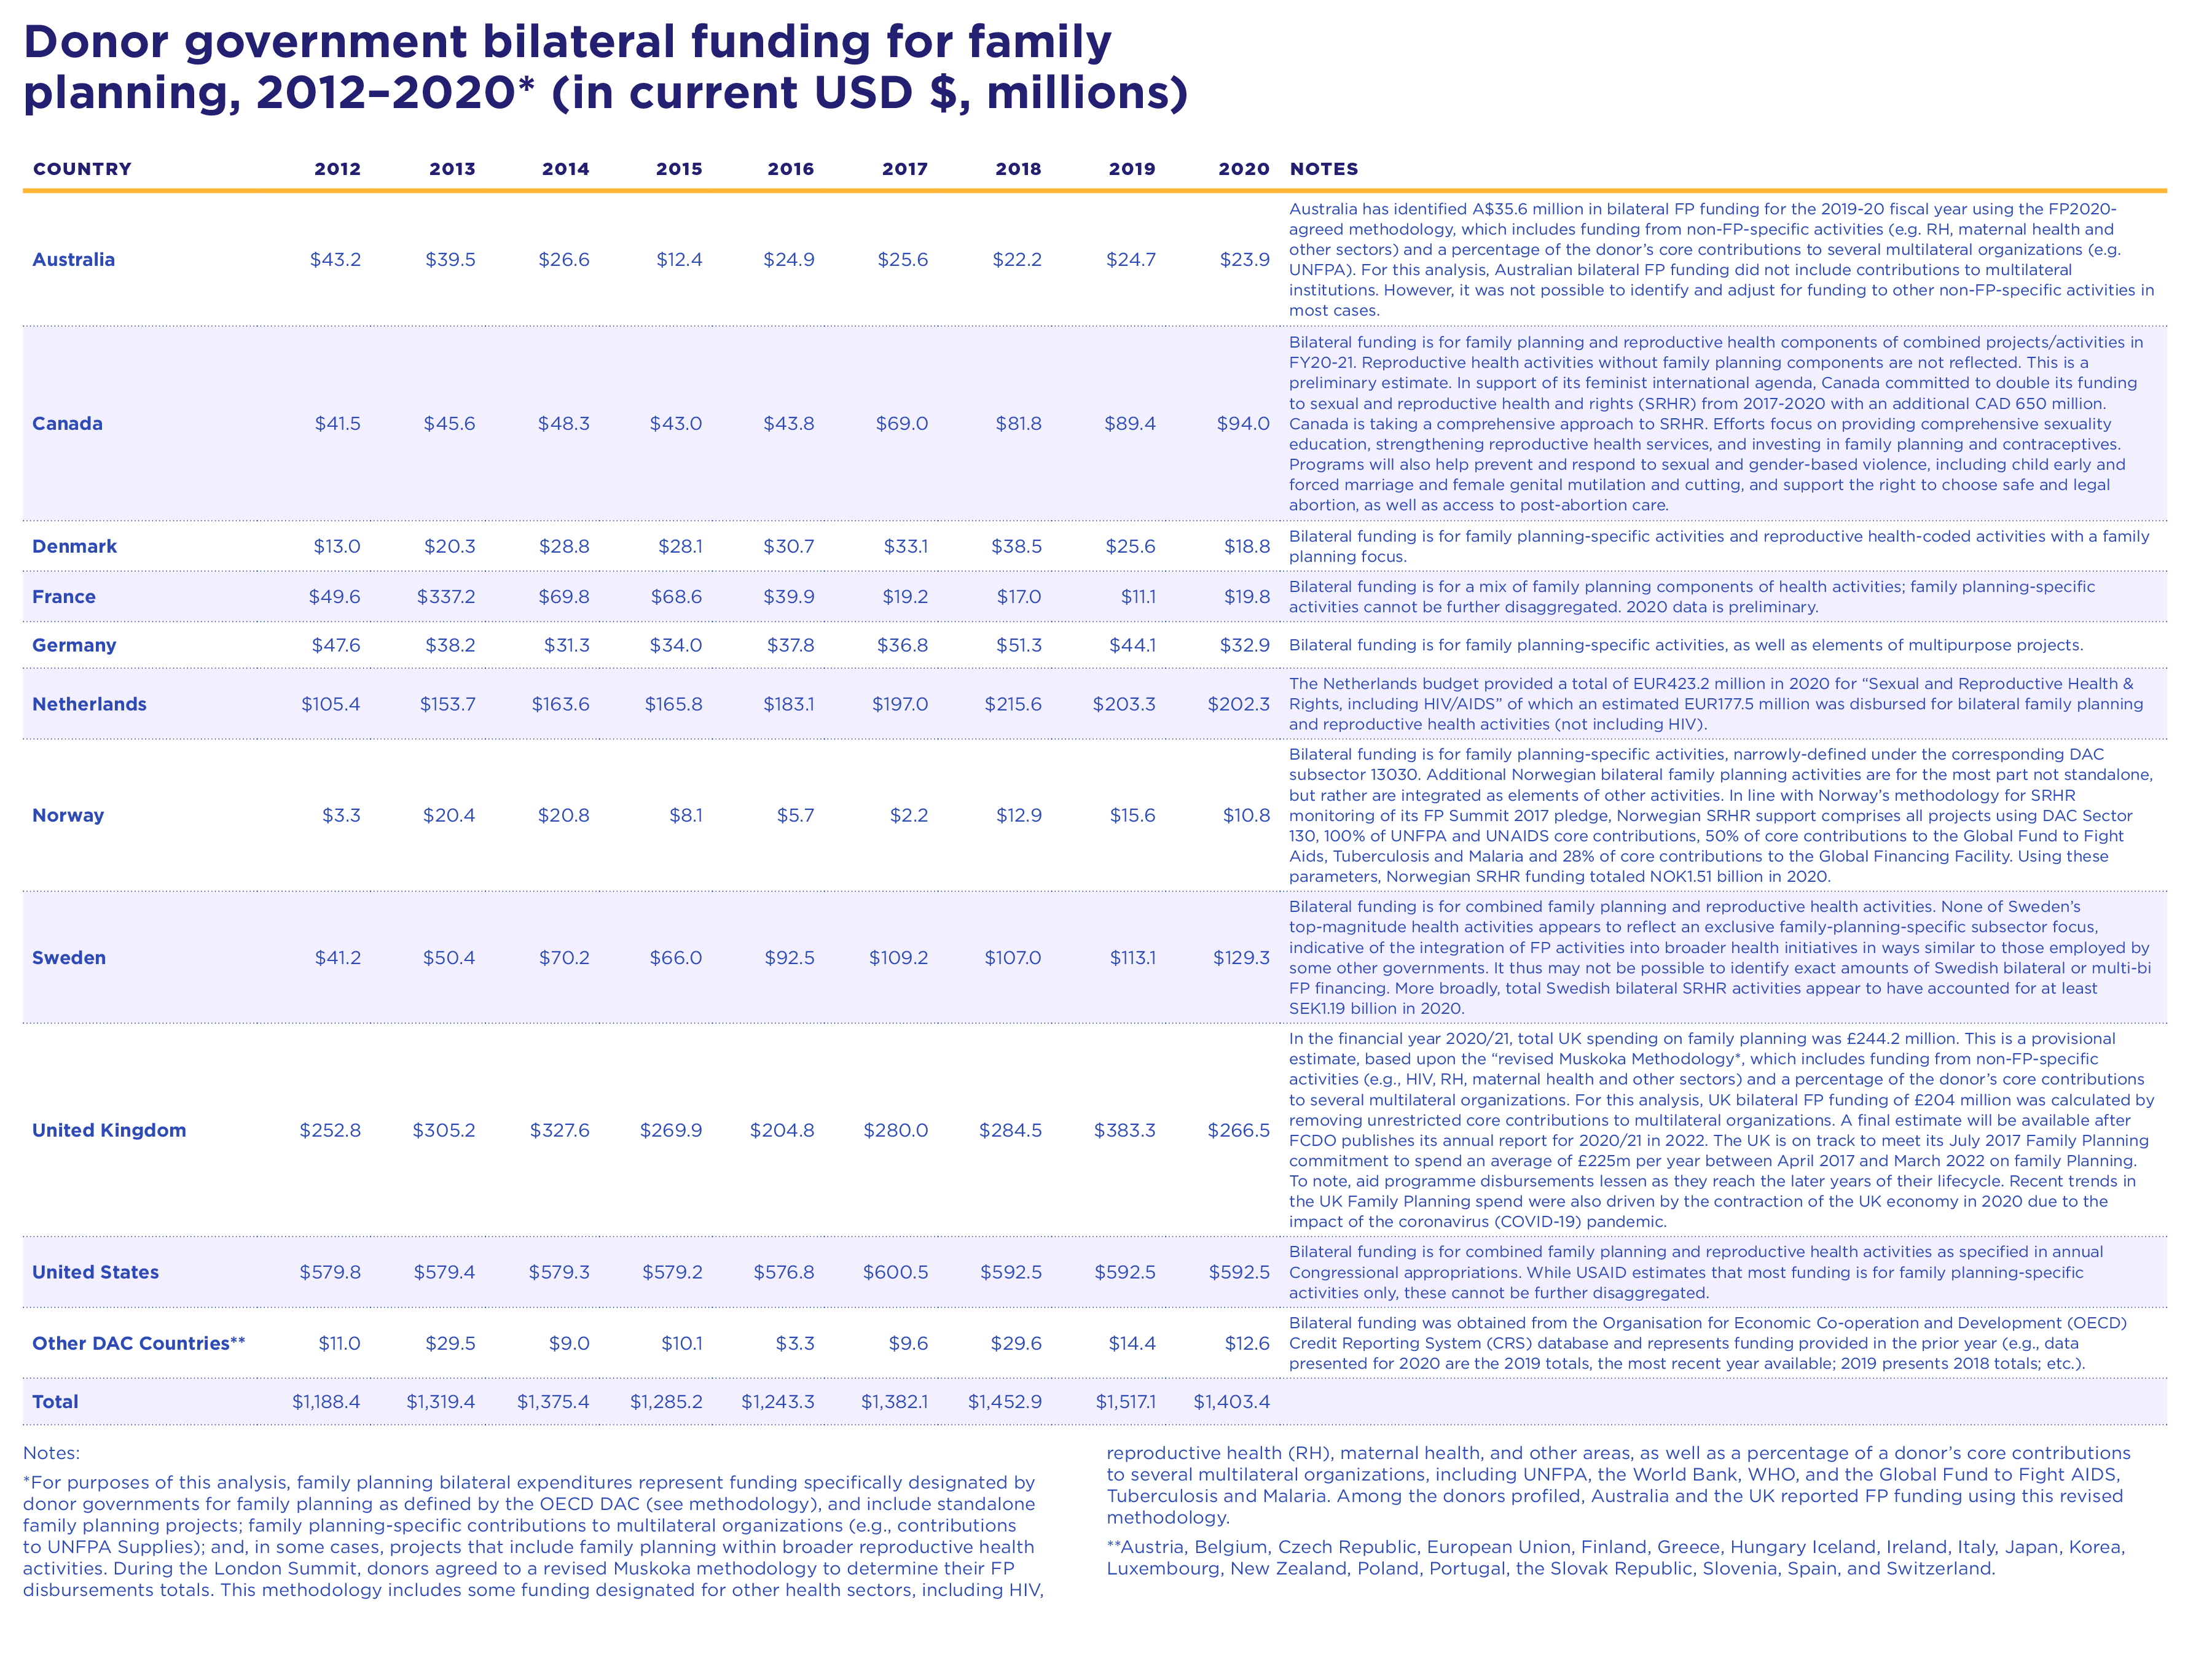

Slide 16
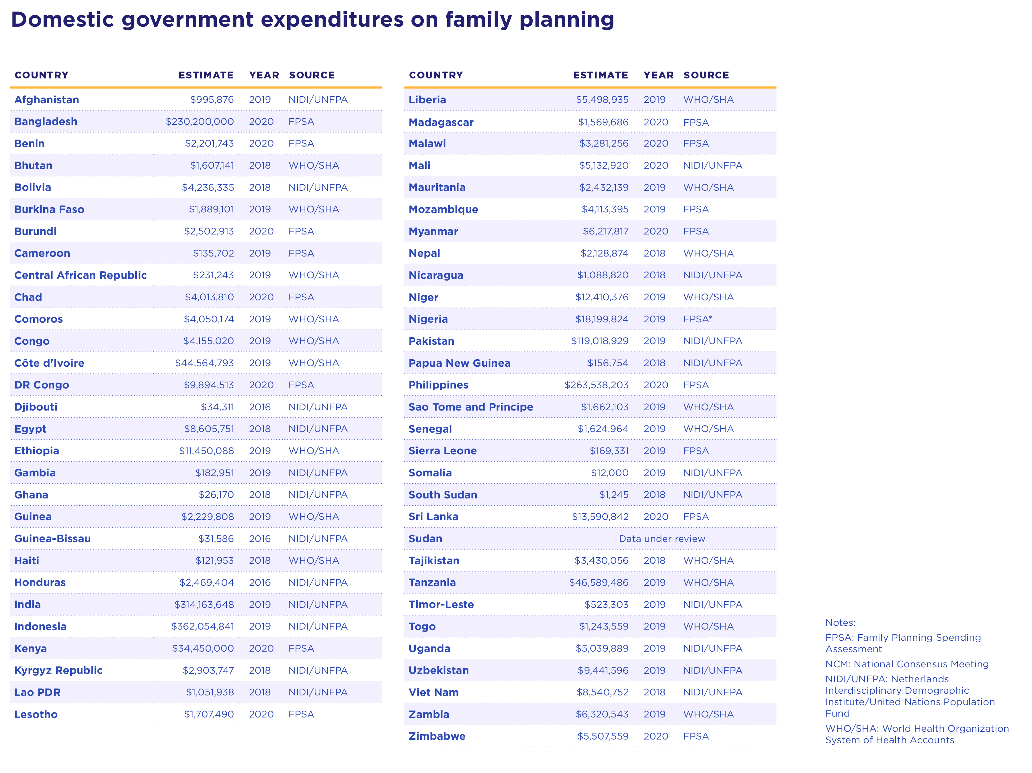

Slide 17
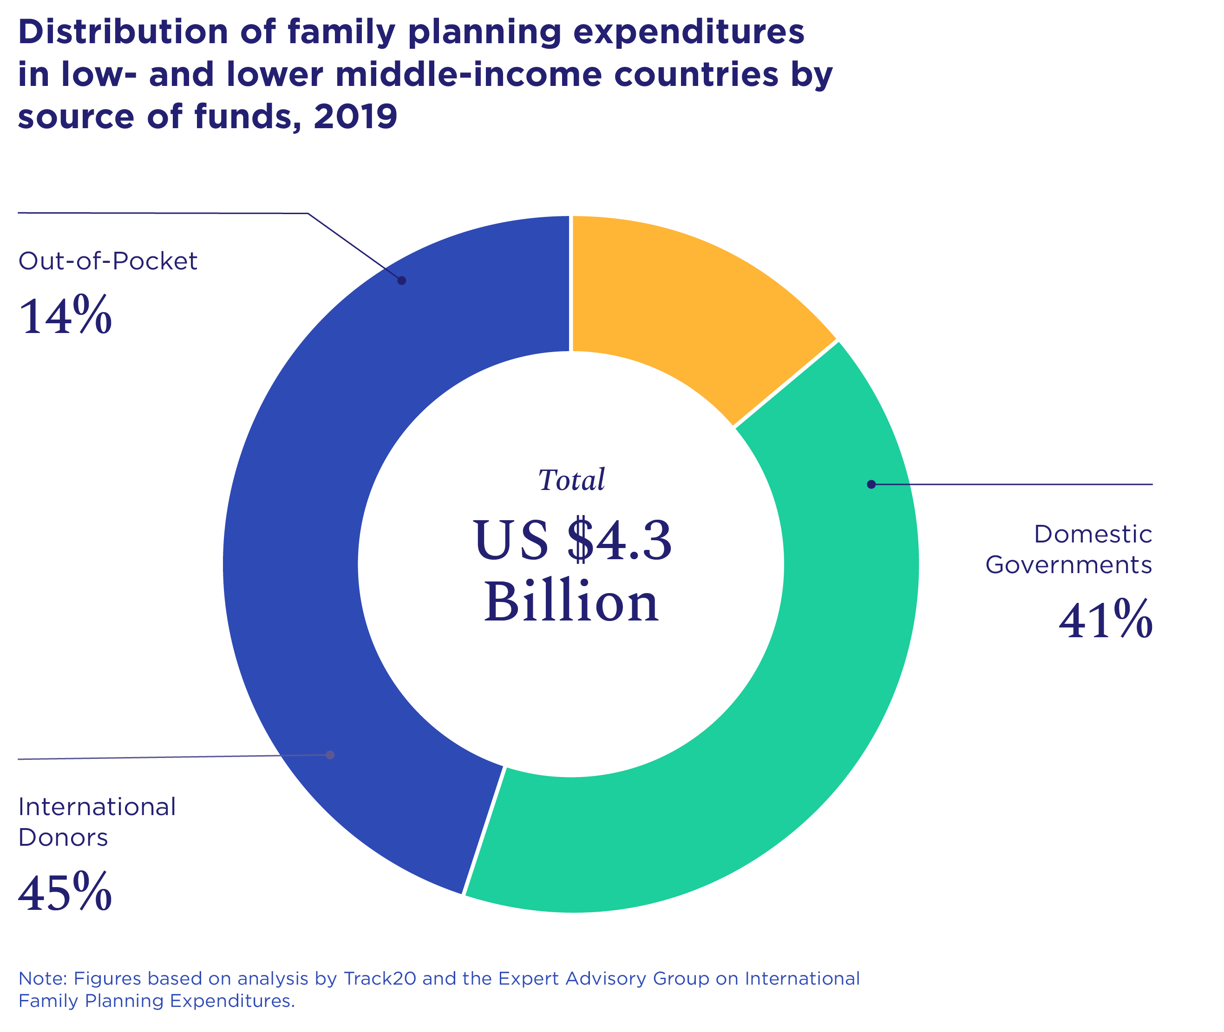

Slide 18

COVID-19 Impacts

Slide 19
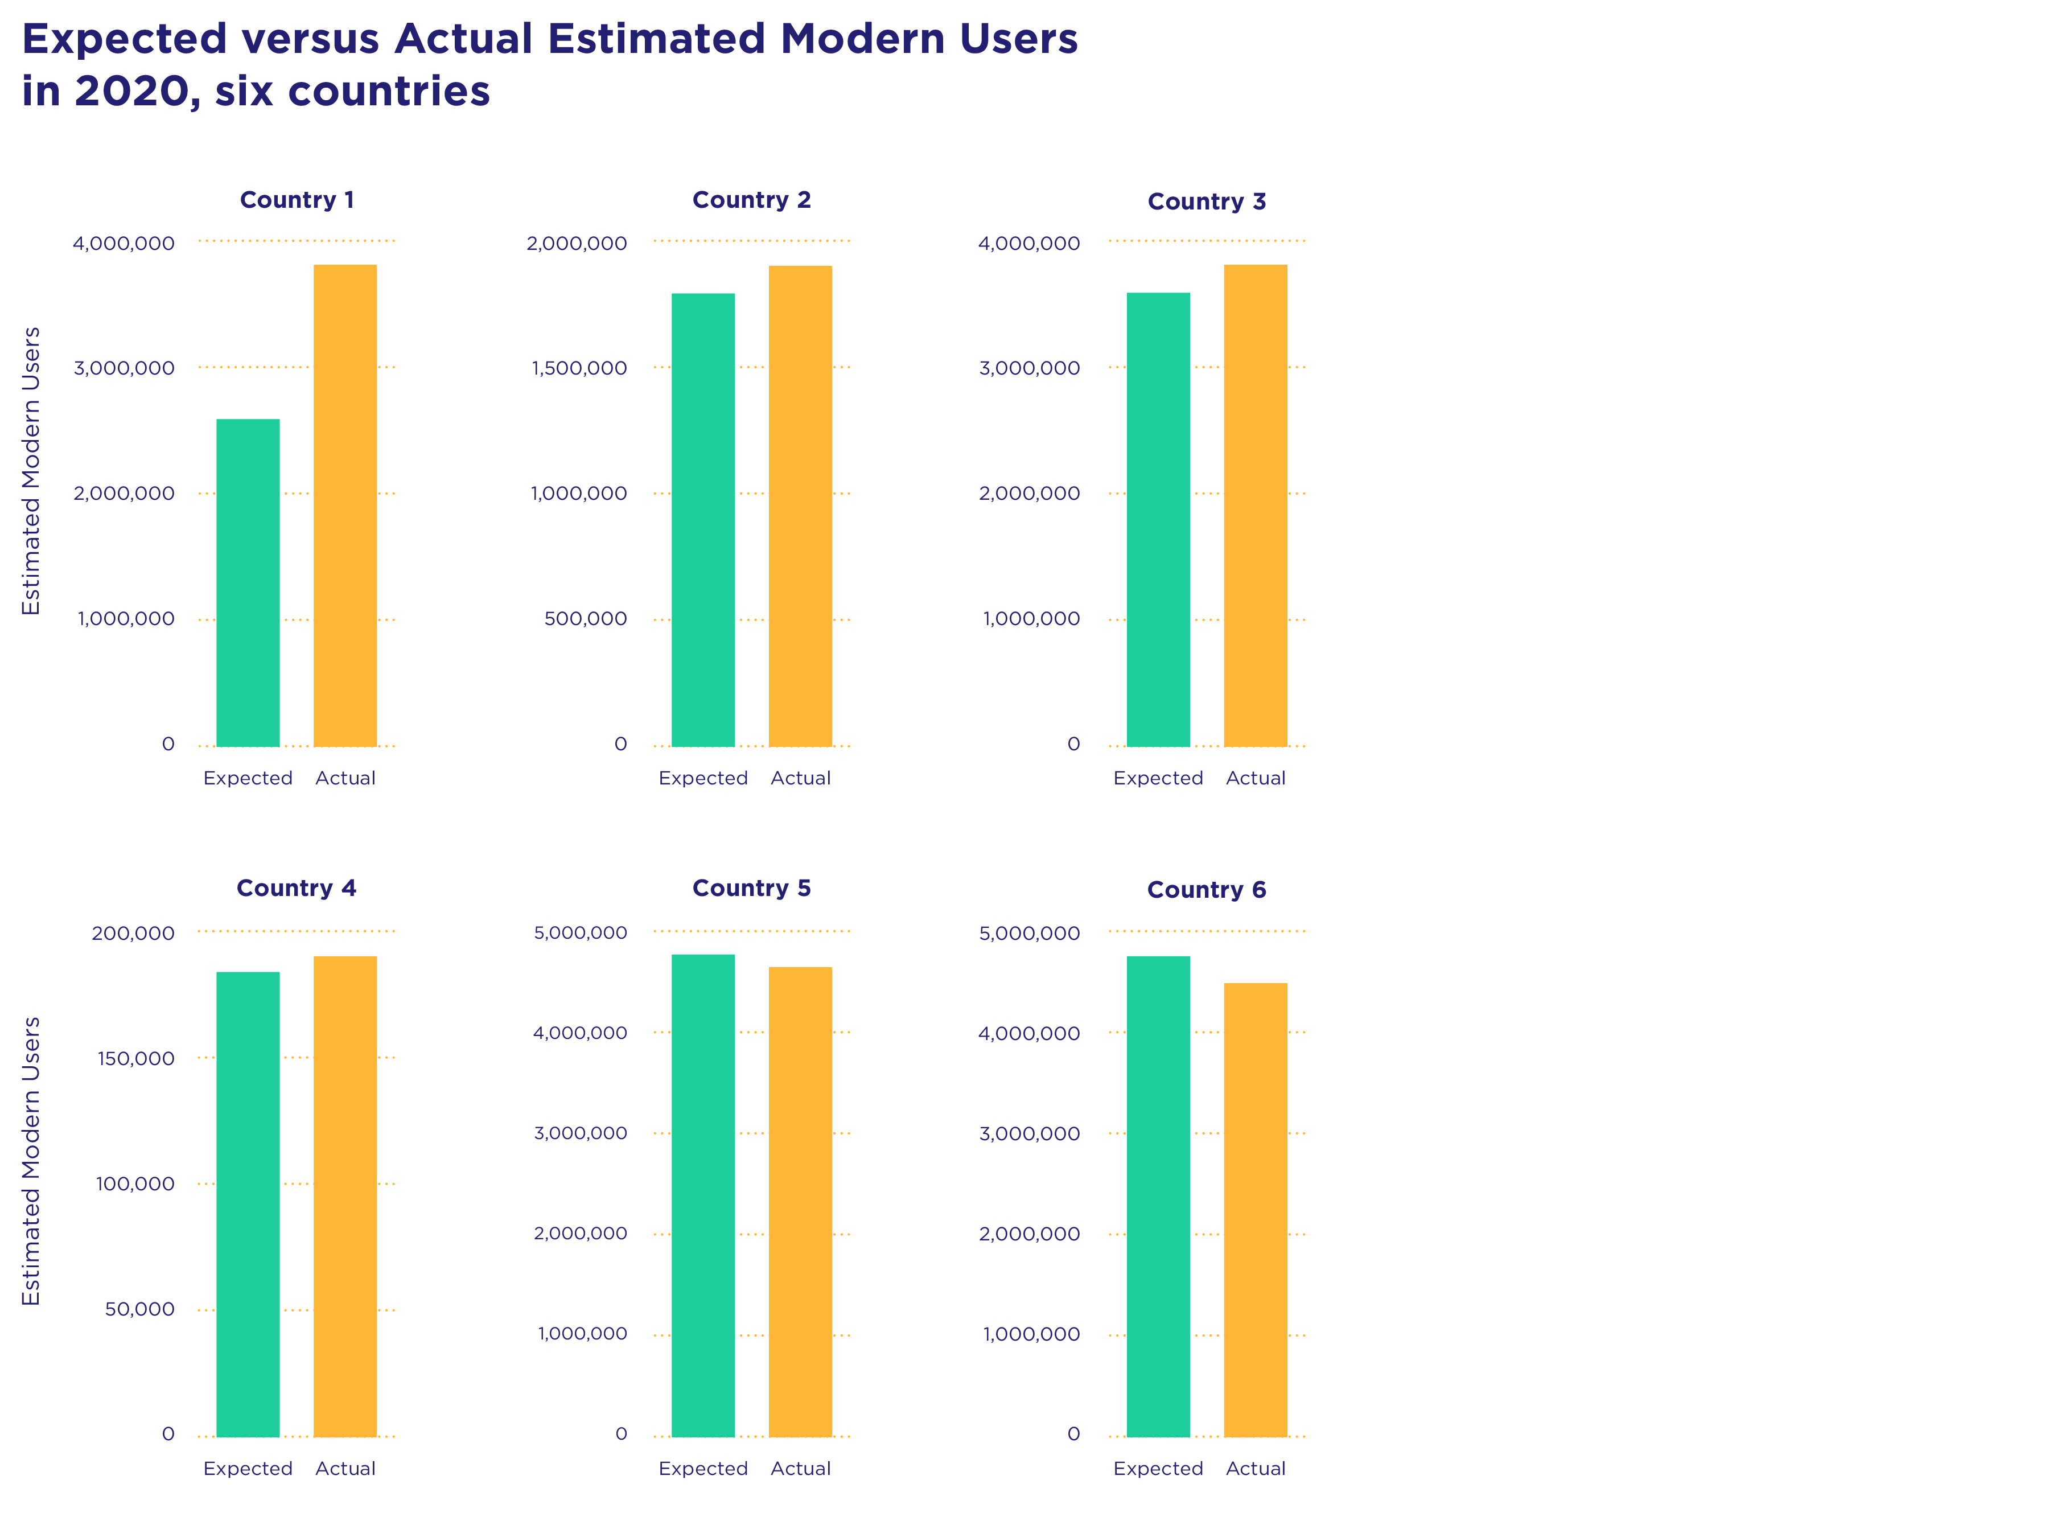
Notes:
This graphic compares the expected estimated modern users in 2020 in six countries in sub-Saharan Africa and the actual estimated modern users from Health Management Information System (HMIS) service statistics data collected by facilities in those same countries in 2020.

Slide 20
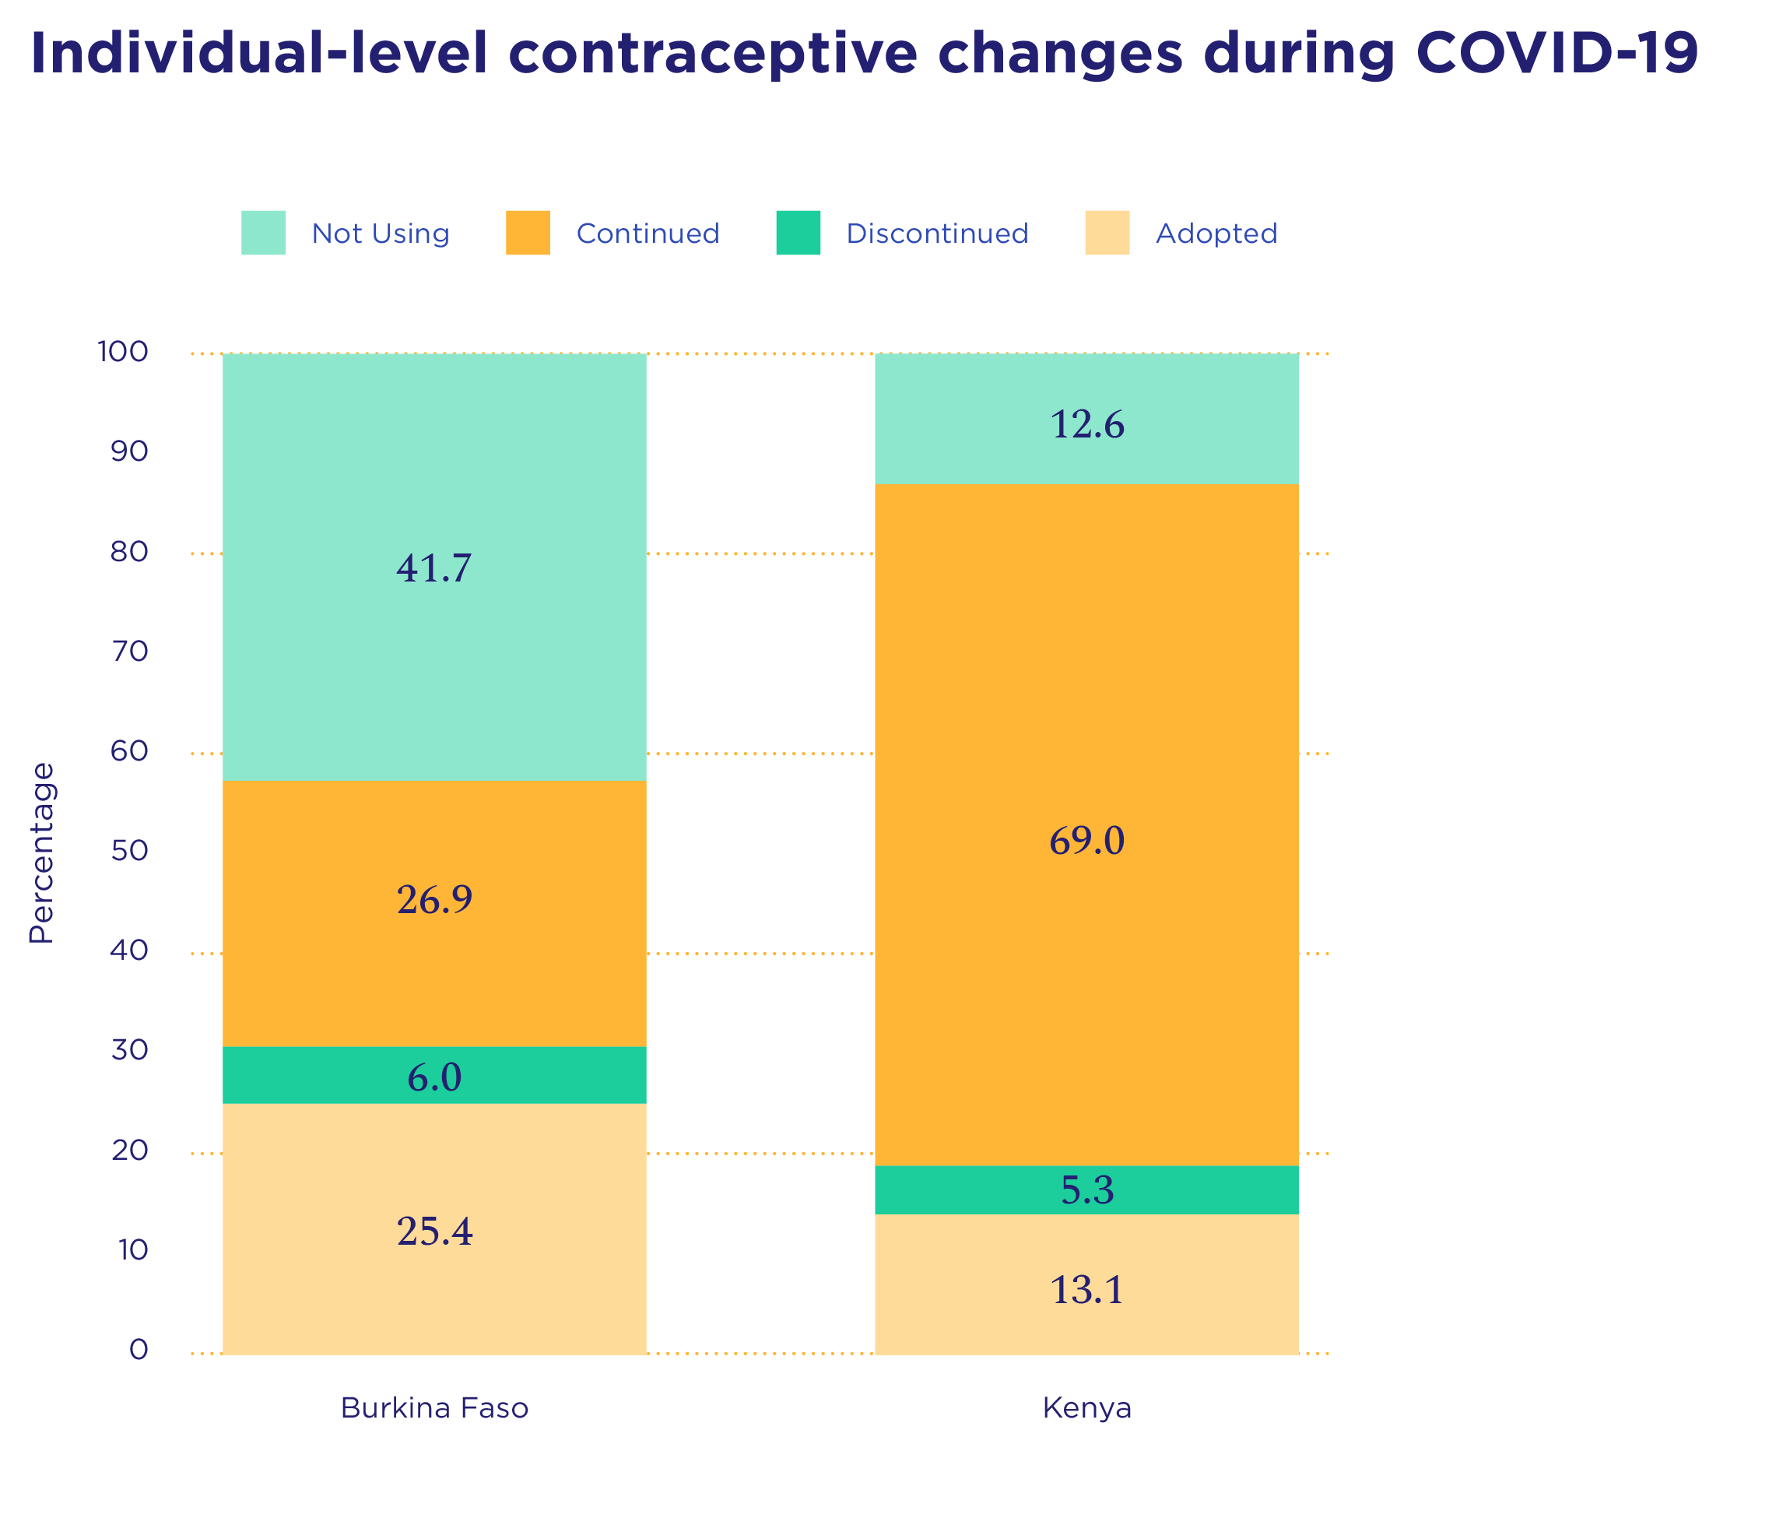
Notes:
This graphic shows individual-level contraceptive changes during COVID-19 in Burkina Faso and Kenya using PMA longitudinal household survey analysis data collected before the pandemic in 2019 and during the pandemic in 2020.

